Slide 1


Predictive Maintenance of Jet Engines Using Sensor Data
Goal: Predict jet engine failures before they occur using deep learning to enable proactive maintenance.
Industrial Problem: Due to unexpected breakdown, shutdown occurs and it increase huge financial loss.
Group Members:
Kishan Cheeramath
Dalmy John
Tomson Roy
Adithye Mathew

Slide 2
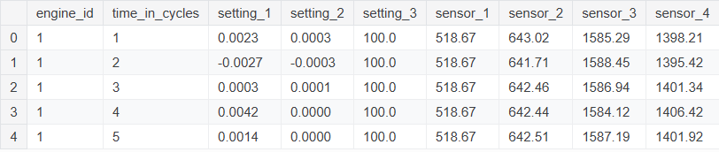
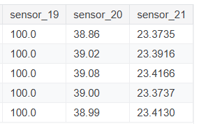
Data Inputs and Assumptions
Dataset Overview
Multivariate time-series sensor data from simulated turbofan engines.
We are using NASA- CMAPPS dataset
Includes three operational settings and 21 sensor measurements, capturing comprehensive engine performance data.
Provided with pre-defined training, testing, and true RUL labels for model development and validation.

Slide 3
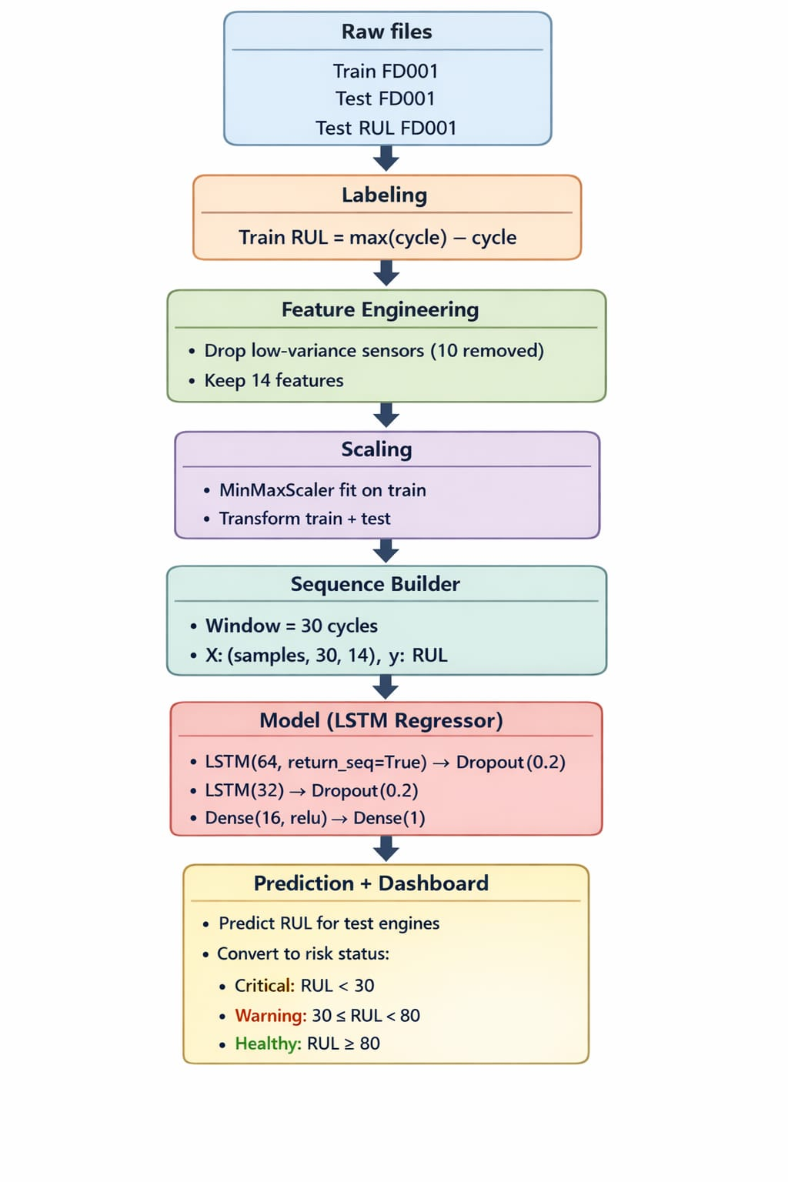
Flow Chart – Algorithm +Simulation

Slide 4
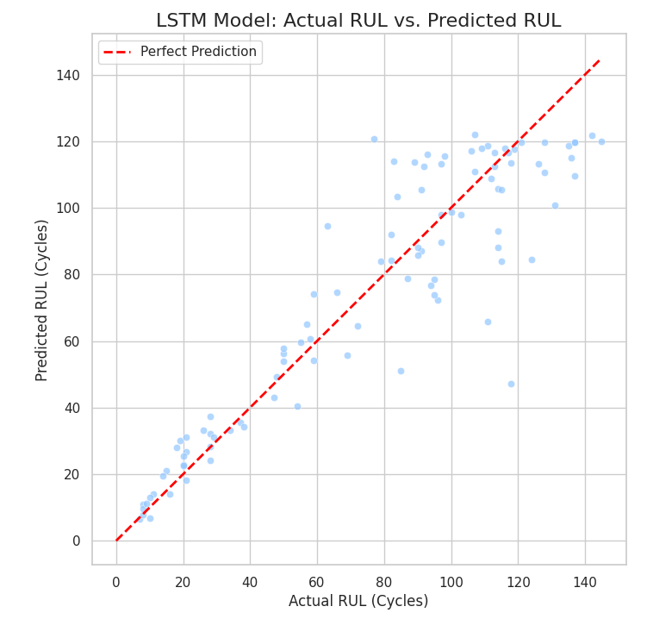
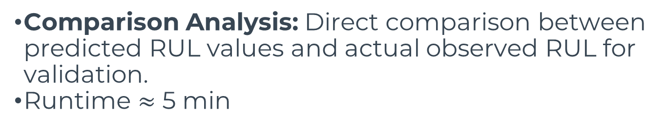
Model Outputs and Performance
Key Outputs
Predicted Remaining Useful Life: A numerical value indicating the estimated operational time left for each engine.
Comparison Analysis: Direct comparison between predicted RUL values and actual observed RUL for validation.
Runtime $≈$ 5 min
Evaluation Metrics
Root Mean Squared Error (RMSE): Quantifies the accuracy of predictions, indicating the average magnitude of the errors.
Prediction Deviation: Measures the spread of predictions relative to actual values, highlighting consistency.

Slide 5
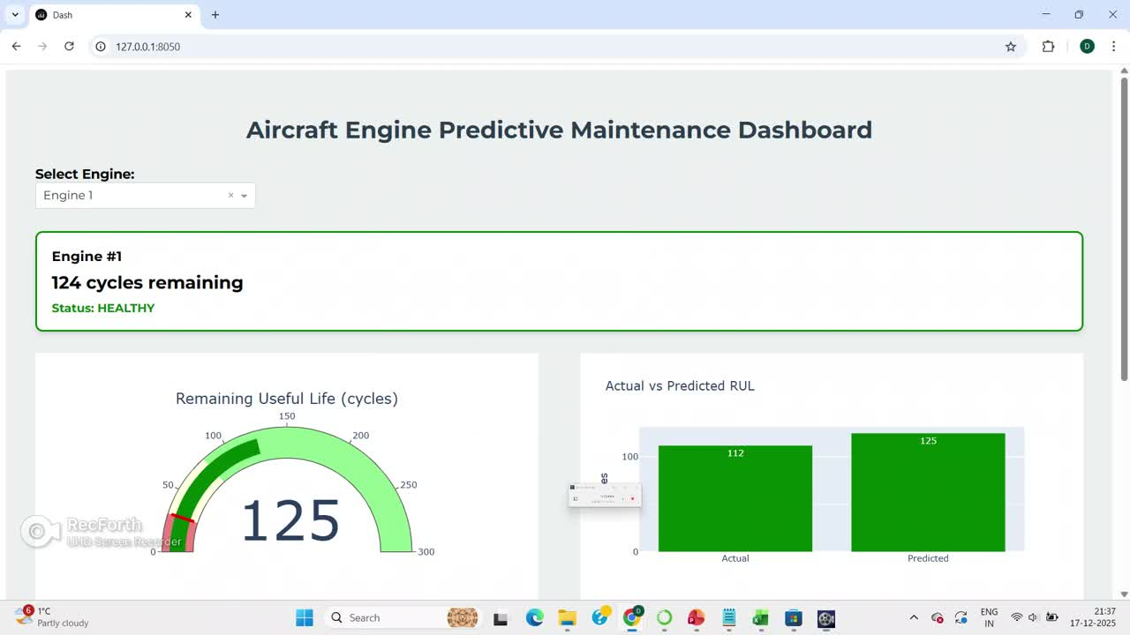


Slide 6
Comparison with Baseline Approaches
LSTM is superior because it can learn long-term temporal degradation patterns from sequential sensor data, which Random Forest cannot model inherently.
Models | RMSE
Random Forest Regressor | 41.47
LSTM | 24.04

Slide 7

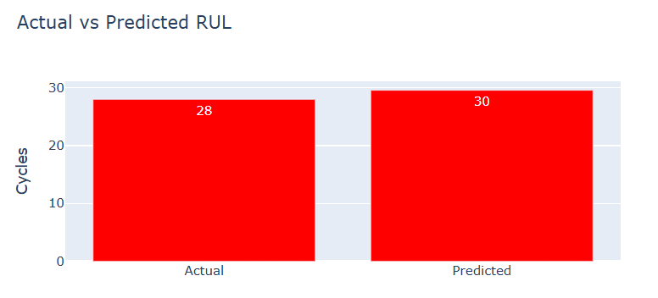
Model Validation Strategy
Validation is performed by testing the trained model on unseen engines and comparing predicted RUL with true RUL

Slide 8

Key Deliverables
Working RUL Prediction Pipeline: A fully functional system for predicting engine Remaining Useful Life.
Condition-Based Maintenance Support: Provides critical data for optimizing maintenance schedules, moving from reactive to proactive strategies.
Dashboard with clear indications with critical, warning and healthy conditions.
The three-tier system mirrors real maintenance protocols:
CRITICAL (< 30 cycles): Ground the aircraft immediately, schedule emergency maintenance.
WARNING (30–80 cycles): Plan maintenance within the next mission cycle.
HEALTHY (> 80 cycles): Continue normal operations.

Slide 9
Limitations
Model validated only on FD001 dataset (single operating condition).
Performance depends on quality and consistency of sensor data.
Limited interpretability of deep learning predictions.
Real-time deployment aspects not addressed.

